Slide 1

Unit 2
Histograms

Slide 2
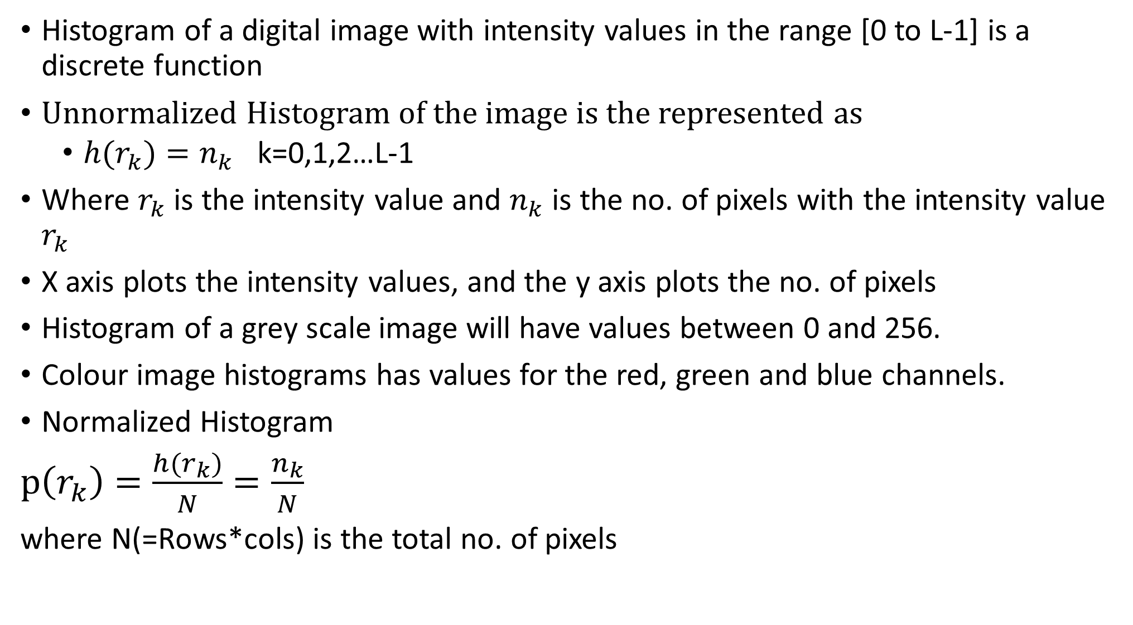
Histogram of a digital image with intensity values in the range [0 to L-1] is a discrete function
Unnormalized Histogram of the image is the represented as
$h(r_{k})=n_{k}$ k=0,1,2…L-1
Where $r_{k}$ is the intensity value and $n_{k}$ is the no. of pixels with the intensity value $r_{k}$
X axis plots the intensity values, and the y axis plots the no. of pixels
Histogram of a grey scale image will have values between 0 and 256.
Colour image histograms has values for the red, green and blue channels.
Normalized Histogram
$p\left(r_{k}\right)=\frac{{h(r}_{k})}{N}=\frac{n_{k}}{N}$
where N(=Rows*cols) is the total no. of pixels

Slide 3
Histogram example
Grey Level | No. of pixels
0 | 3
1 | 5

Slide 4
Binary image

Slide 5
384x 512 image

Slide 6
Histogram of Red Green and Blue Separate

Slide 7
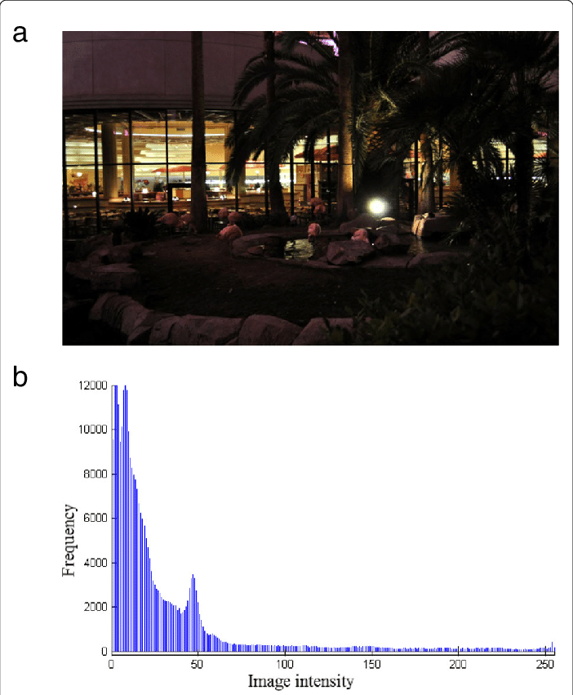
Histogram of a Dark Image

Slide 8
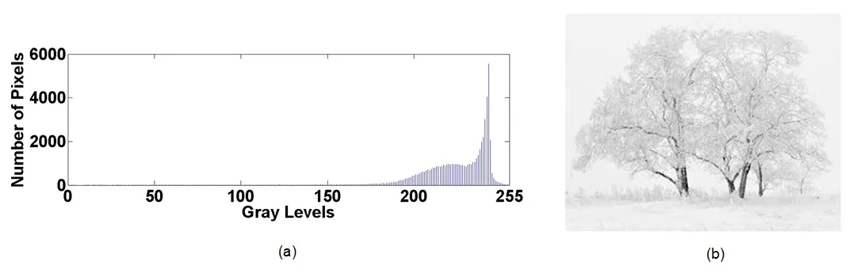
Histogram of a Bright image

Slide 9
Histogram of a Low contrast image

Slide 10
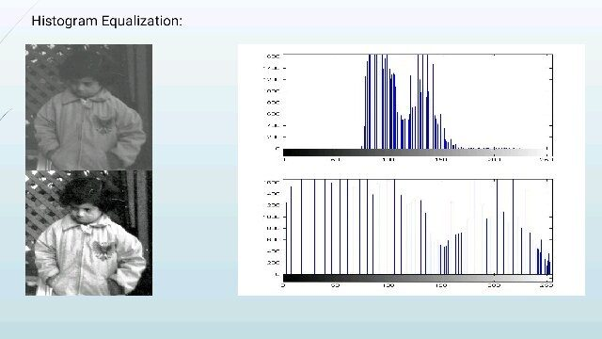
Histogram of a Low contrast image

Slide 11
Histograms can be used for plotting frequency as well as the cumulative frequency of the intensity values of an image.
Cumulative frequency: No of pixels that lie above or below a certain value
Found by adding each frequency to the sum of its predecessors
Frequency | Cumulative frequency
1 | 1
2 | 3
3 | 6
4 | 10
5 | 15

Slide 12
Histogram Equalization
Used for image enhancement
Done by stretching the intensity range of the image so it spans the whole range of intensity values.
As a result, low contrast areas of the image gains high contrast

Slide 15
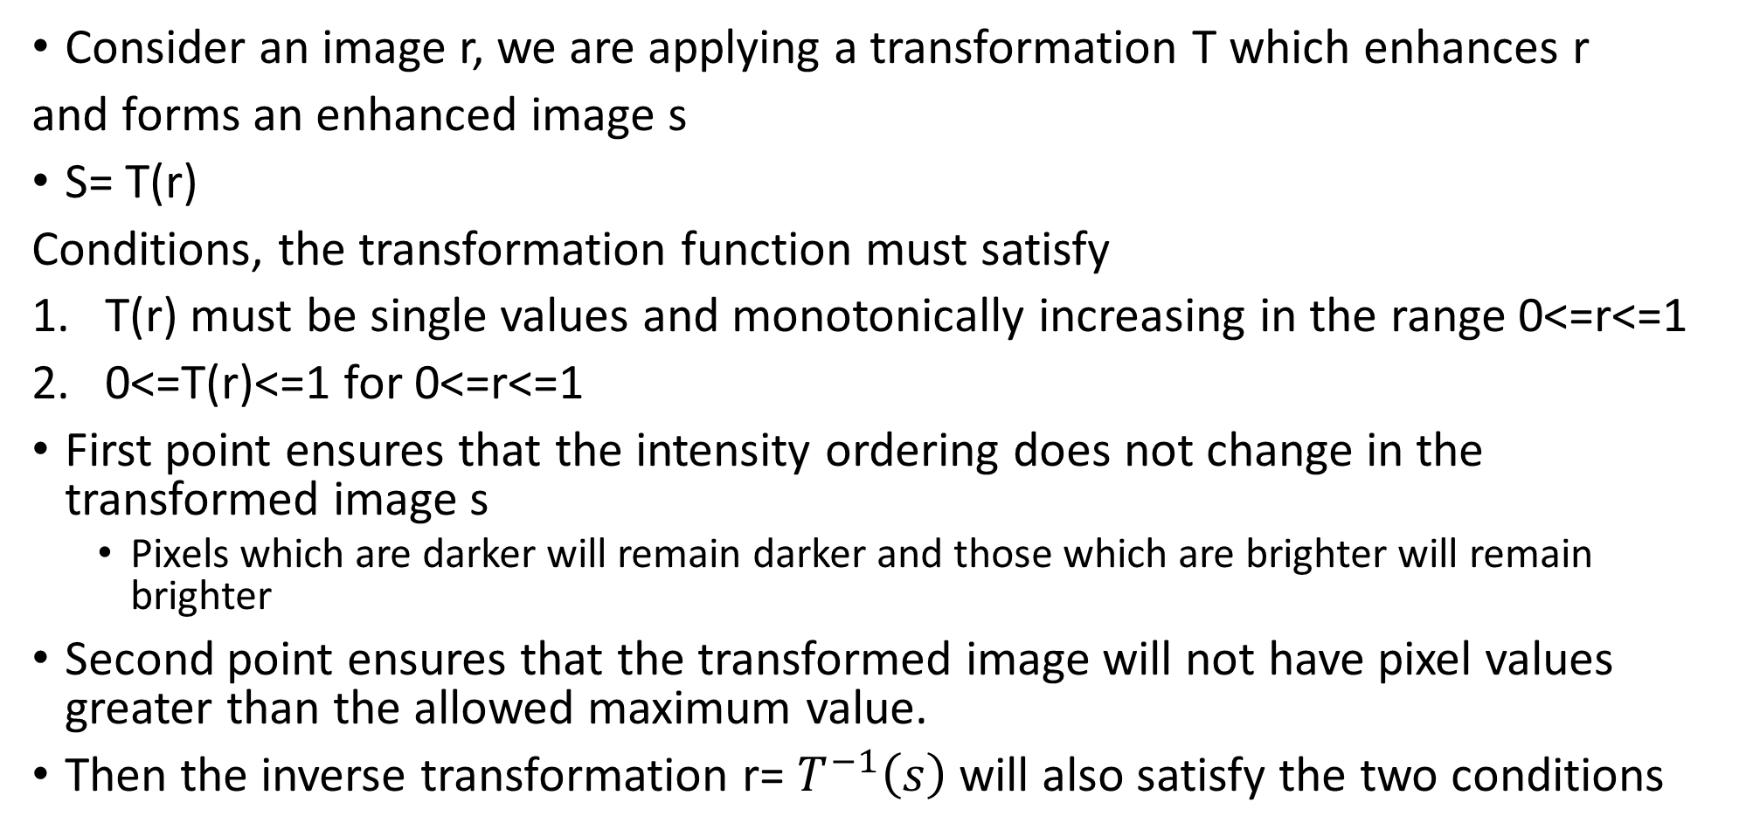
Histogram Equalization
Consider an image r, we are applying a transformation T which enhances r
and forms an enhanced image s
S= T(r)
Conditions, the transformation function must satisfy
T(r) must be single values and monotonically increasing in the range 0<=r<=1
0<=T(r)<=1 for 0<=r<=1
First point ensures that the intensity ordering does not change in the transformed image s
Pixels which are darker will remain darker and those which are brighter will remain brighter
Second point ensures that the transformed image will not have pixel values greater than the allowed maximum value.
Then the inverse transformation r= $T^{−1}\left(s\right)$ will also satisfy the two conditions

Slide 17
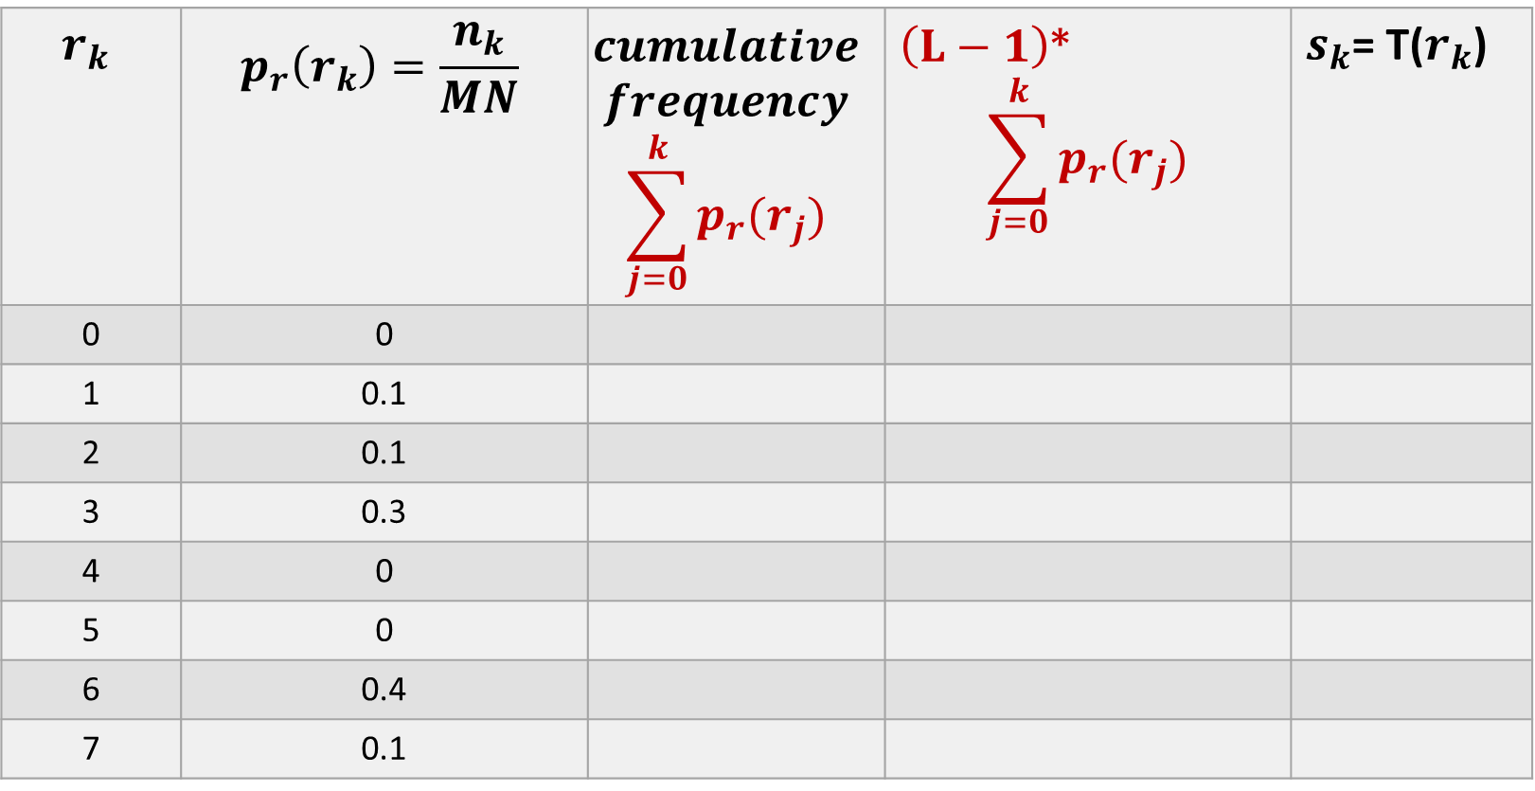

Transformation function for Histogram Equalization is :
$s_{k}=T{(r}_{k })=(L−1)\sum_{j=0}^{k}{p_{r}(r_{j})}$ k=0,1,2…L-1
$$r_{k}$$ | $$p_{r}\left(r_{k}\right)=\frac{n_{k}}{MN}$$ | $$cumulative$$ $$frequency$$ $$\sum_{j=0}^{k}{p_{r}(r_{j})}$$ | $\left(L−1\right)$* $$\sum_{j=0}^{k}{p_{r}(r_{j})}$$ | $s_{k}$= T($r_{k}$)
0 | 0
1 | 0.1
2 | 0.1
3 | 0.3
4 | 0
5 | 0
6 | 0.4
7 | 0.1

Slide 18
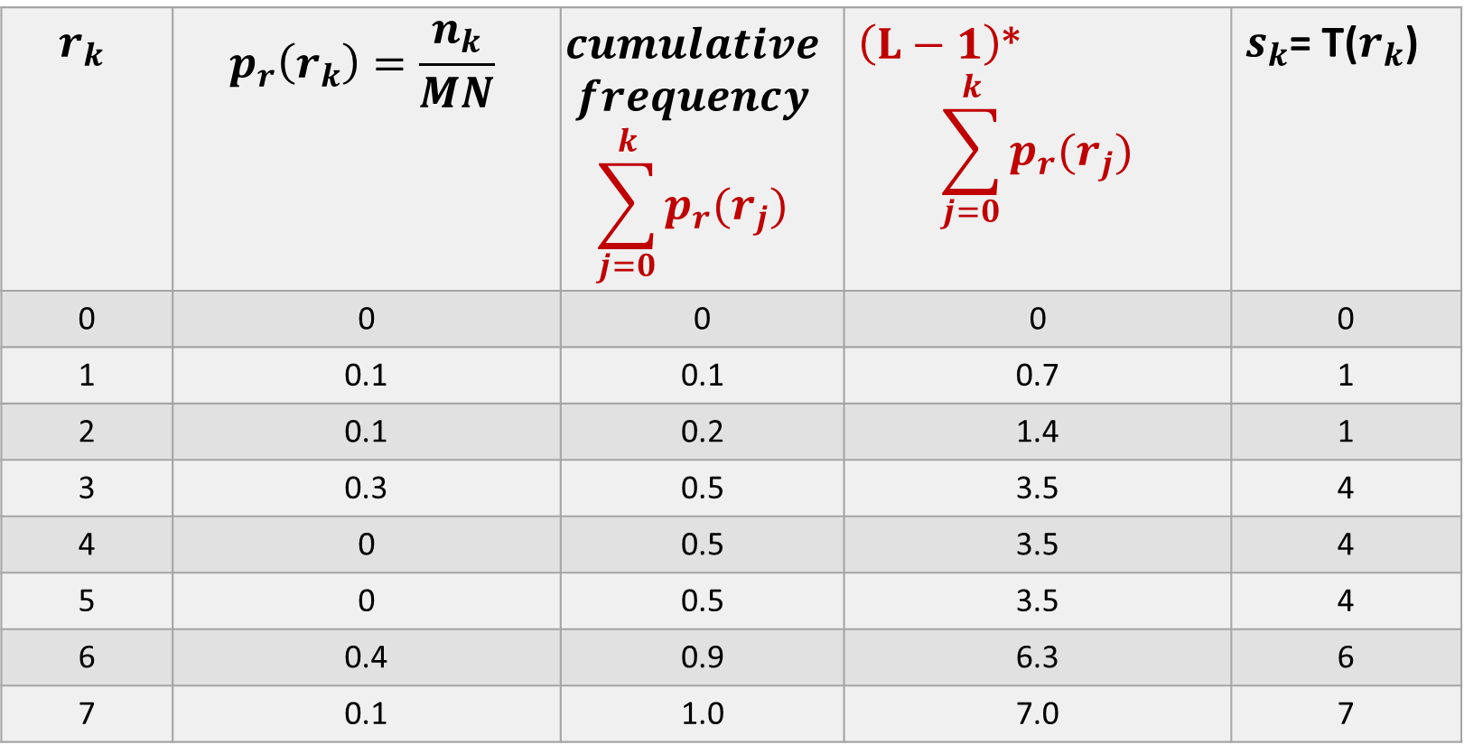
Transformation function for Histogram Equalization is :
$s_{k}=T{(r}_{k })=(L−1)\sum_{j=0}^{k}{p_{r}(r_{j})}$ k=0,1,2…L-1
$$r_{k}$$ | $$p_{r}\left(r_{k}\right)=\frac{n_{k}}{MN}$$ | $$cumulative$$ $$frequency$$ $$\sum_{j=0}^{k}{p_{r}(r_{j})}$$ | $\left(L−1\right)$* $$\sum_{j=0}^{k}{p_{r}(r_{j})}$$ | $s_{k}$= T($r_{k}$)
0 | 0 | 0 | 0 | 0
1 | 0.1 | 0.1 | 0.7 | 1
2 | 0.1 | 0.2 | 1.4 | 1
3 | 0.3 | 0.5 | 3.5 | 4
4 | 0 | 0.5 | 3.5 | 4
5 | 0 | 0.5 | 3.5 | 4
6 | 0.4 | 0.9 | 6.3 | 6
7 | 0.1 | 1.0 | 7.0 | 7

Slide 19
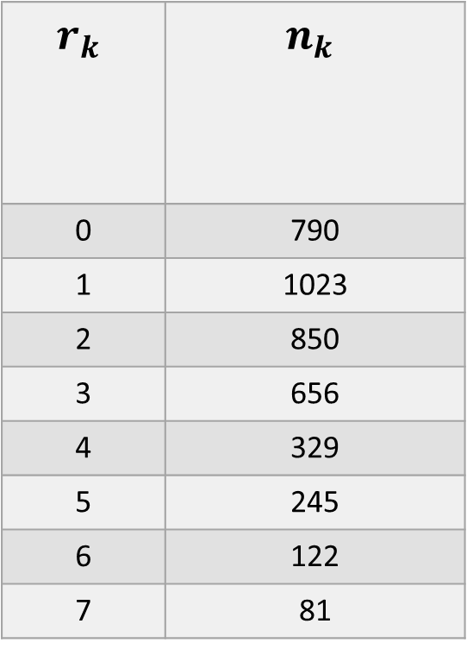
Transformation function for Histogram Equalization is :
$s_{k}=T{(r}_{k })=(L−1)\sum_{j=0}^{k}{p_{r}(r_{j})}$ k=0,1,2…L-1
$$r_{k}$$ | $$n_{k}$$
0 | 790
1 | 1023
2 | 850
3 | 656
4 | 329
5 | 245
6 | 122
7 | 81

Slide 20
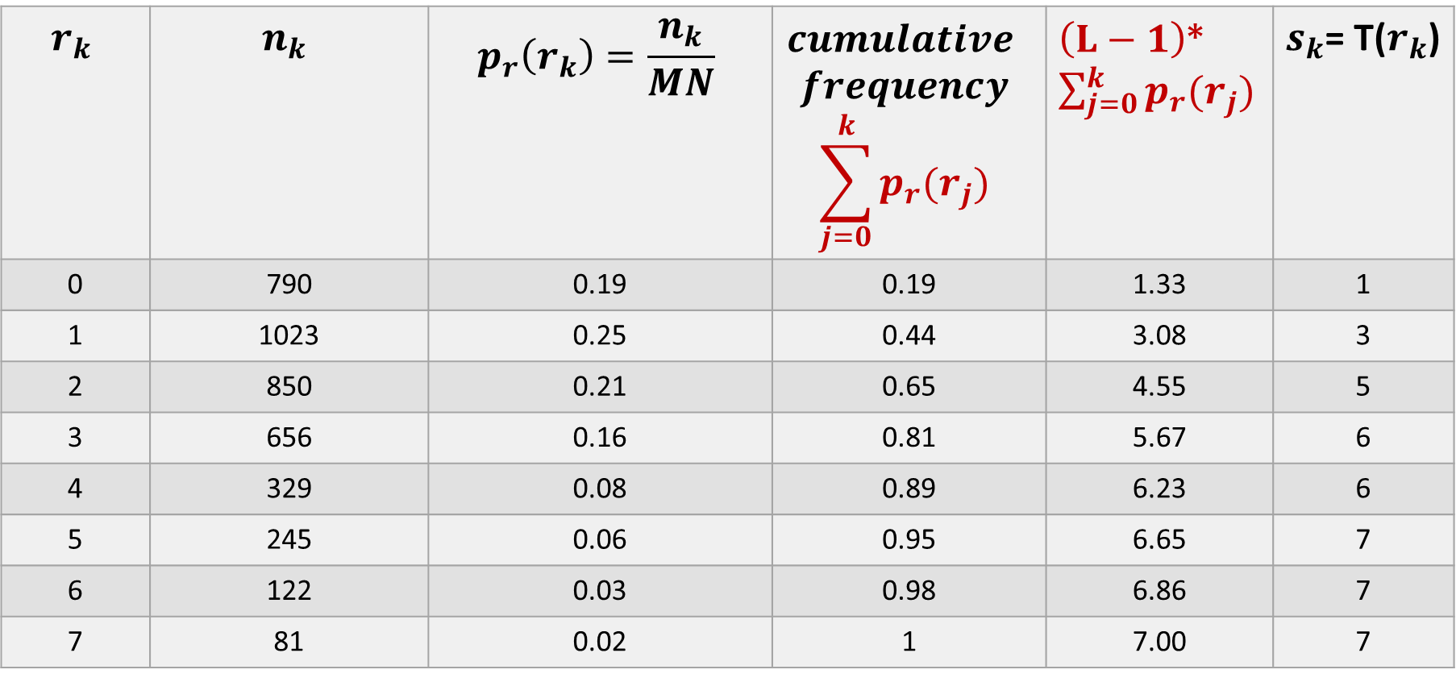
Transformation function for Histogram Equalization is :
$s_{k}=T{(r}_{k })=(L−1)\sum_{j=0}^{k}{p_{r}(r_{j})}$ k=0,1,2…L-1
$$r_{k}$$ | $$n_{k}$$ | $$p_{r}\left(r_{k}\right)=\frac{n_{k}}{MN}$$ | $$cumulative$$ $$frequency$$ $$\sum_{j=0}^{k}{p_{r}(r_{j})}$$ | $\left(L−1\right)$* $\sum_{j=0}^{k}{p_{r}(r_{j})}$ | $s_{k}$= T($r_{k}$)
0 | 790 | 0.19 | 0.19 | 1.33 | 1
1 | 1023 | 0.25 | 0.44 | 3.08 | 3
2 | 850 | 0.21 | 0.65 | 4.55 | 5
3 | 656 | 0.16 | 0.81 | 5.67 | 6
4 | 329 | 0.08 | 0.89 | 6.23 | 6
5 | 245 | 0.06 | 0.95 | 6.65 | 7
6 | 122 | 0.03 | 0.98 | 6.86 | 7
7 | 81 | 0.02 | 1 | 7.00 | 7

